Slide 1
OJH Math Team 2025-2026
Year in Review

Slide 2
Important Metrics
383 Pizzas; Average cost of $9.83/pizza; about $5/student per day
  Thank you parents!
Took apart and re-assembled the Orchestra room 33 times
Ate pies at pie day
  Chocolate Cream was popular
  Cherry was not
Ate ice cream
Earned 243 bonus work points
15 people correctly memorized the prime numbers under 100
14 people correctly memorized the first 4 Pythagorean triples
Appeared on Good Day Dayton

Slide 3
Competitions
AMC 8
  16 competed; 11 scored in top 25%
Math Olympiad
  28 competed
  OJH scored in top 25%
  6 students scored in top 25%
SMOY Mini-mathcounts
  9 OJH and 2 Smith competed
University of Cincinnati Math Bowl
  3 students

Slide 4
Competitions - MathCounts
School MathCounts
  25 competed in school competition
  15 competed in Dayton Chapter at Wright State
    + 10 Smith/Harman 6th graders
Won Dayton Chapter MathCounts
  B team would have been 3rd or 4th
  11 of top 30 students were OJH
  7 OJH students qualified for State MathCounts
  5 of the 12 students in the countdown round were OJH Students
State MathCounts
  8th place team (out of 151 Ohio teams)
  3rd highest team round

Slide 5
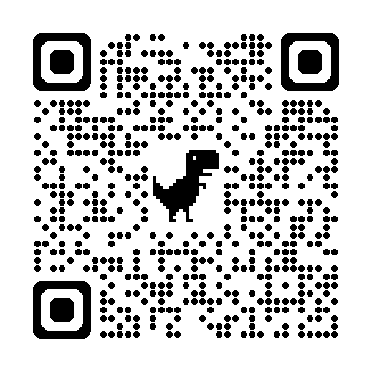
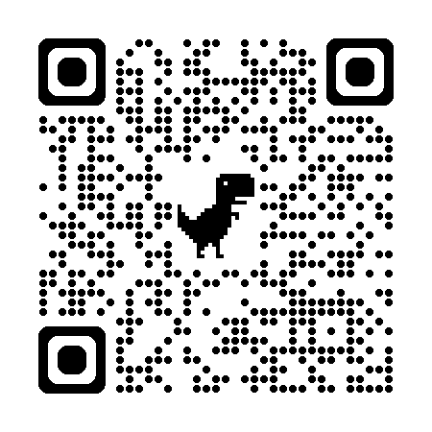

Oakwood Math Team Summer Challenges
Evan Simpson hosting camp at library (TBD)
Art of the Possible MathCounts Trainer: https://aops.com/mc
  To earn a prize: Increase your current level by 10. (If you have not done it before, you just need to get to level 10)
Contest Math Course:
  Use this link to create a Brilliant account and join the OJH Math Team classroom: https://brilliant.org/classroom/join-v2/6b2bca53-1c03-4c1d-aeeb-909d07ab8963
  Use this to take the Contest Math Course: https://brilliant.org/courses/math-competition-fundamentals
Completing the Brilliant.org Contest Math Course

Slide 6
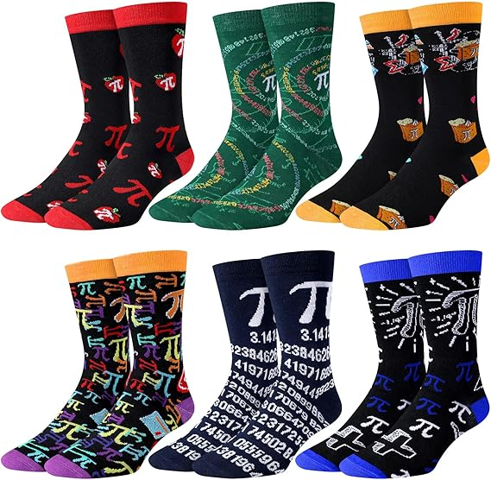
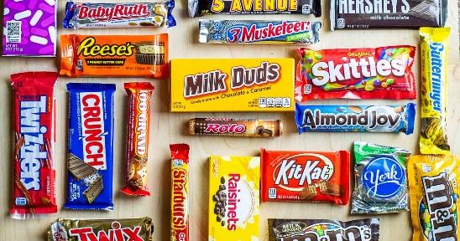
Oakwood Math Team Summer Challenge Prizes
Full size candy bar and/or Pi socks
One prize for each challenge (MC Trainer or Brilliant.org)

Slide 7
Who can win prizes?
Oakwood students who will be in 6th, 7th, 8th, or 9th grade in Fall 2026
Any current or future Oakwood Math Team Coaches

Slide 8
2026-2027 School Year
7th graders: I hope you return to the team as 8th graders (and bring friends)
8th graders: If you are interested in being a coach, keep an eye out for an email over the summer
Coaches: I hope you come back as coaches next year
8th graders and coaches: Mrs. Saule talked to us about OHS Math Club
  They meet on Friday at lunch in Mrs. Saule’s room
  The code to the google classroom is: 7ewx7nk

